Slide 1
CAPSTONE PROJECT
Project Title
Sales Forecasting Tool For E-commerce
Project Description
This final year project centers around the development of a sophisticated web-based tool tailored for e-commerce platforms. This tool facilitates the seamless registration of both sellers and buyers onto a centralized platform, providing them with a comprehensive suite of features designed to enhance decision-making processes within the e-commerce domain. Upon registering on the platform, users can leverage the tool to access detailed information about specific products listed on e-commerce websites. This includes a retrospective analysis of past sales, robust tracking of various product attributes, and a forward-looking forecasting mechanism. The forecasting component is particularly impactful, enabling sellers to anticipate the future profitability and growth trajectory of a given product. In essence, our project aims to empower sellers with the critical insights necessary for strategic analysis and informed bulk purchasing decisions. As we undertake this final year endeavor, our commitment is to deliver a solution that not only meets academic standards but also contributes substantively to the practical needs of the e-commerce industry. Through meticulous development and rigorous analysis, we aspire to provide a tool that not only facilitates better analysis of products but also assists sellers in making informed decisions regarding bulk purchases, ultimately optimizing their profitability. Advantages/Impact: 1. Empowers sellers with insights for strategic product analysis and bulk purchasing. 2. Distinguishes businesses through the introduction of advanced sales forecasting. 3. Maximizes efficiency by tapping into established international market infrastructure. 4. Engages a global community for collaborative feedback and continuous improvement. 5. Provides a comprehensive view of both local and international markets for well-rounded strategic planning.
Student Names
M Adnan Malik (F20605005) || Hassan Asif (F20605033) || Mehmood ul Haq (F20605012) || Muhammad Usama (F20605046)
Advisor | Co-Advisor
Dr. Benish | Dr. Ali Arshad

Slide 2
Literature Review
Project Title : Sales Forecasting Tool For E-commerce
Market Analysis (Adnan Malik) Similar Tools Analysis (Adnan Malik) Point of Uniqueness (Hassan Asif) Data Gathering (Muhammad Usama) Technologies Research (Mehmood ul Haq)

Slide 3
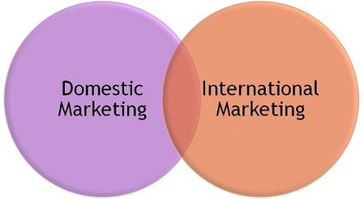
Literature Review
Project Title : Sales Forecasting Tool For E-commerce
Market Analysis (Local & International) 1. Market Analysis Scope: Exploration of local and international markets. 2. International Market Advantage: Focus on the international market due to established infrastructure and robust community support. 3. Resource-Rich Environment: Utilizing international market resources for optimal tool development. 4. Community-Driven Development: Leveraging strong international community support for collaborative tool refinement. 5. Global-Local Connectivity: Strategically analyzing and fostering connectivity between international and local markets for mutual benefit.

Slide 4



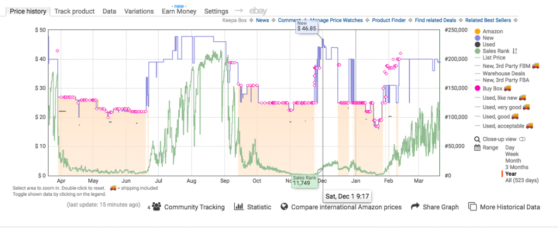
Literature Review
Project Title : Sales Forecasting Tool For E-commerce
2. Similar Tools Analysis 1. Competitive Landscape Analysis: In-depth examination of similar tools in the market to gain insights into their functionalities. 2. Focus on Industry Leaders: Concentration on well-established tools like Keepa, Jungle Scout, Helium 10 for comprehensive analysis. 3. Documentation and Hands-On Exploration: Thorough examination of tool documentations and hands-on experience with tools such as Keepa, Jungle Scout, Helium 10. 4. Commonality in Past Sales Analysis: Recognition that existing tools, including Keepa, Jungle Scout, Helium 10, share common ground in past sales analysis. 5. Sales Forecasting Enhancement: Distinguishing our project through the introduction of sales forecasting, an innovative enhancement not present in existing tools.

Slide 5
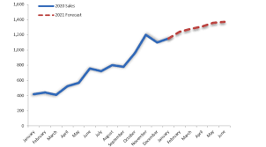
Literature Review
Project Title : Sales Forecasting Tool For E-commerce
Point of Uniqueness: In our extensive research, we've identified a distinctive gap in existing e-commerce tools. Most platforms predominantly offer sales tracking features, lacking the crucial ability to forecast future sales. This revelation serves as a key differentiator for our software. Unlike current solutions that rely on manual analysis for predicting future sales, our software introduces a revolutionary feature. It enables e-commerce sellers to effortlessly project future sales for multiple products in a fraction of the time. This innovation simplifies and accelerates the decision-making process, positioning our software as a pioneering tool in the e-commerce industry, where foresight is key to success.

Slide 6

Literature Review
Project Title : Sales Forecasting Tool For E-commerce
Data Gathering: APIs help us get the latest data about our products fast. They make it simple and fast to collect the information we need. APIs ensure the data we get is accurate and up-to-date. APIs smoothly work with our e-commerce systems without any hitches. We can efficiently follow how each product is selling. With instant access to the right info, our sales forecasts become more accurate.

Slide 7

Literature Review
Project Title : Sales Forecasting Tool For E-commerce
Technologies Research Programming Language: - Python: Widely used for machine learning and web development. 2. Web Framework: - Django or Flask: For building the web application. 3. Database: - PostgreSQL or MySQL: Reliable relational databases for storing product and sales data. 4. Frontend Development: - HTML, CSS, JavaScript: For building the user interface. - React/Next or Angular: Popular frontend libraries/frameworks for dynamic web applications 5. Machine Learning Libraries: - Scikit-learn: For building and training machine learning models. - TensorFlow or PyTorch: For deep learning models if needed. 6. Data Processing and Analysis: - Pandas: For data manipulation and analysis. - NumPy: For numerical operations on data.

Slide 8

Literature Review
Project Title : Sales Forecasting Tool For E-commerce
7. Data Visualization: - Matplotlib and Seaborn: For static visualizations. - Plotly or D3.js: For interactive and dynamic visualizations. 8. Forecasting Models: - Time Series Models: ARIMA, SARIMA, or Prophet for time series forecasting. - Machine Learning Models: Random Forest, Gradient Boosting, or XGBoost for more complex patterns. 9. APIs: - Web scraping or APIs to fetch data from e-commerce websites. Be sure to respect terms of service. 10. Authentication and Authorization: - Use a framework like OAuth for secure user authentication.

Slide 9
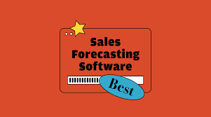
Problem Statement
Sales Forecasting Tool For Ecommerce
Enhancing Ecommerce Sales Forecasting with Modern Login/Signup Pages Introduction: Our sales forecasting tool integrates advanced login/signup interfaces for heightened functionality. Features: Seamless Authentication with JWT Tokens Customizable User Profiles with Tailwind CSS Advanced Analytics powered by React Components Secure Authentication using JSON Web Tokens (JWT) Enhanced User Experience through Single Sign-On with Google Account Our landing page serves as the gateway to our sales forecasting tool, providing visitors with a compelling introduction to our solution and encouraging sign-ups for a free trial.

Slide 10
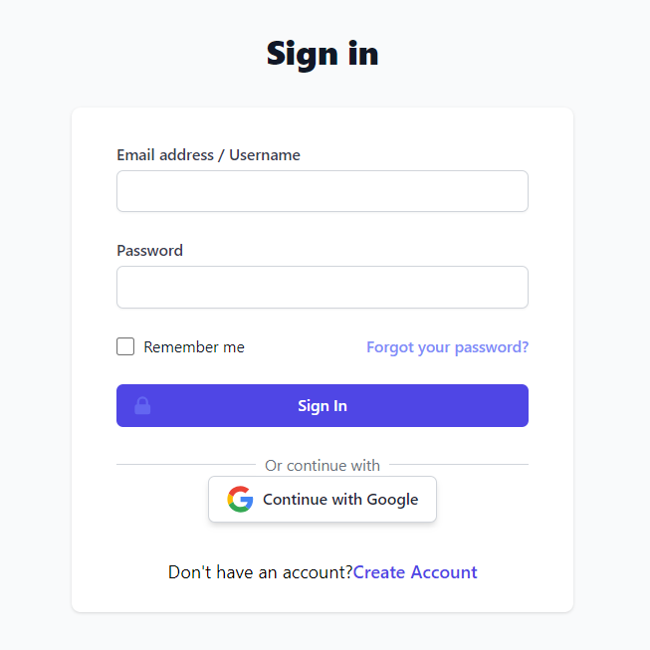
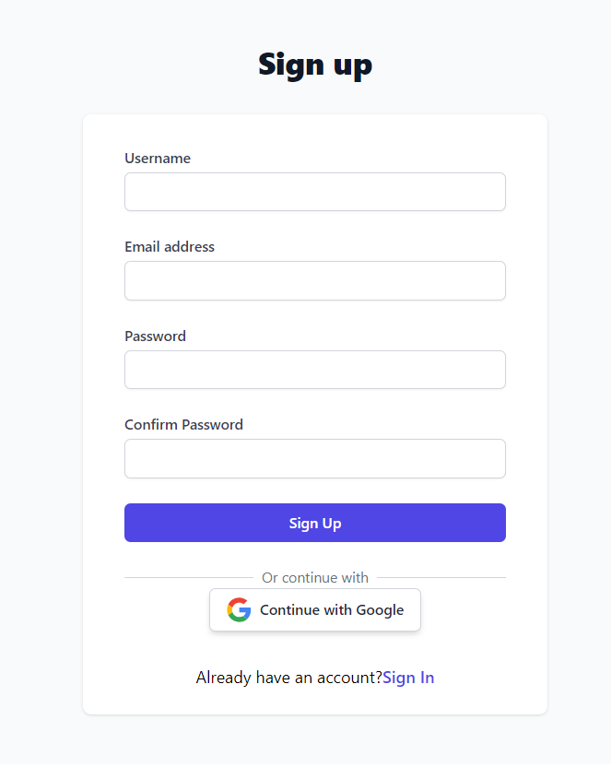
Demo / Working Model
Sales Forecasting Tool For Ecommerce
Sign in Sign Up

Slide 11
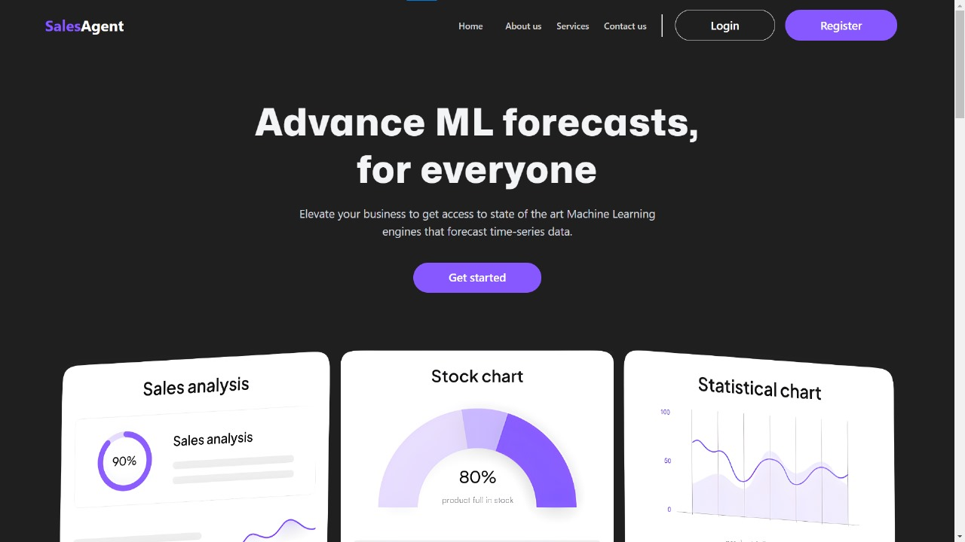
Demo / Working Model
HOME PAGE

Slide 12
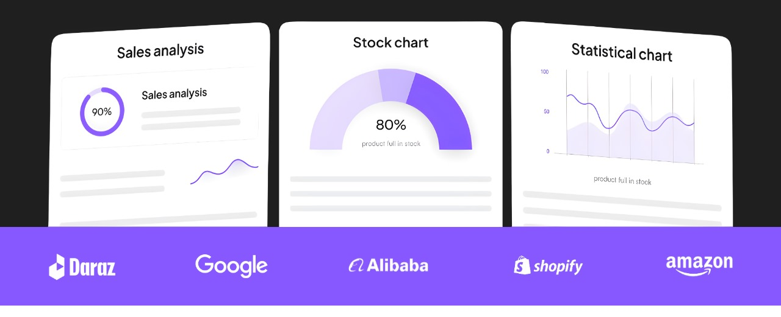
Demo / Working Model
HOME PAGE

Slide 13
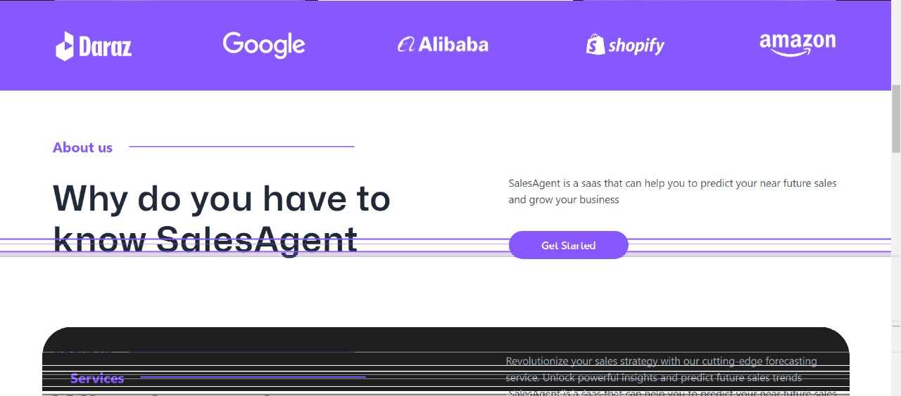
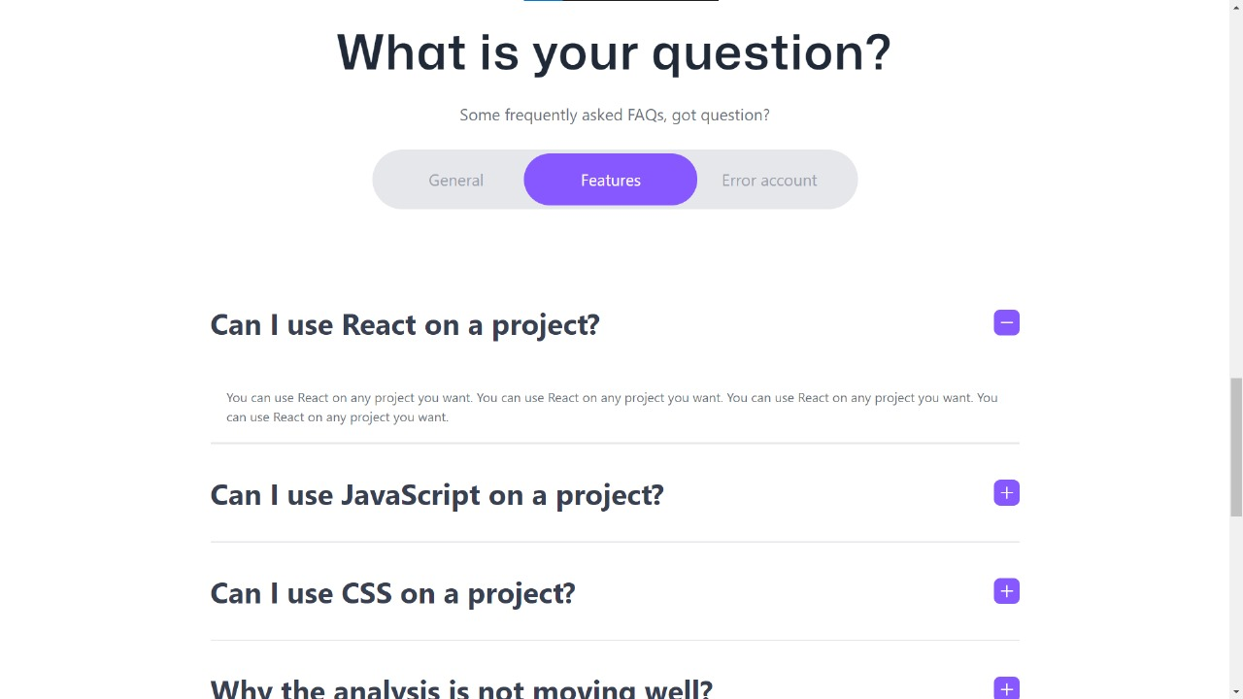
Demo / Working Model
HOME PAGE

Slide 14
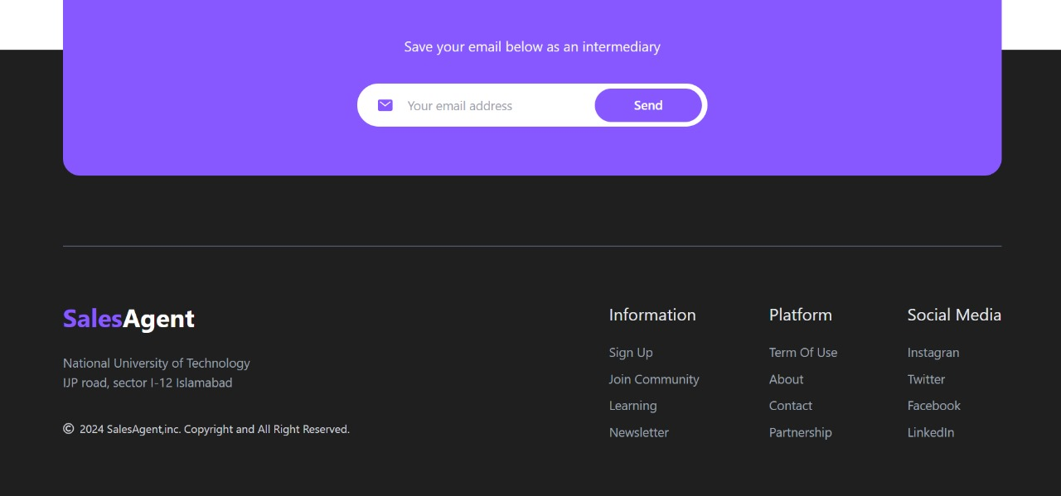
Demo / Working Model
HOME PAGE

Slide 15
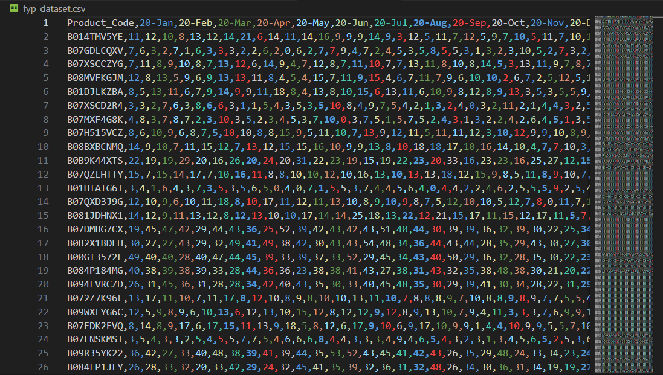
Demo / Working Model
Dataset (1 Million Amazon Products)

Slide 16
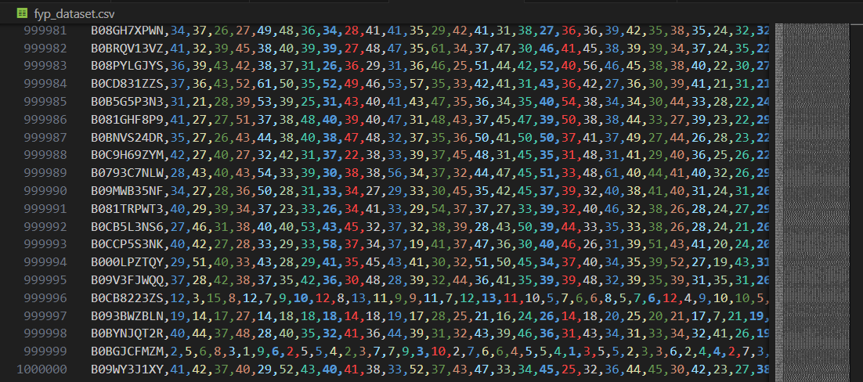
Demo / Working Model
Dataset (1 Million Amazon Products)

Slide 17
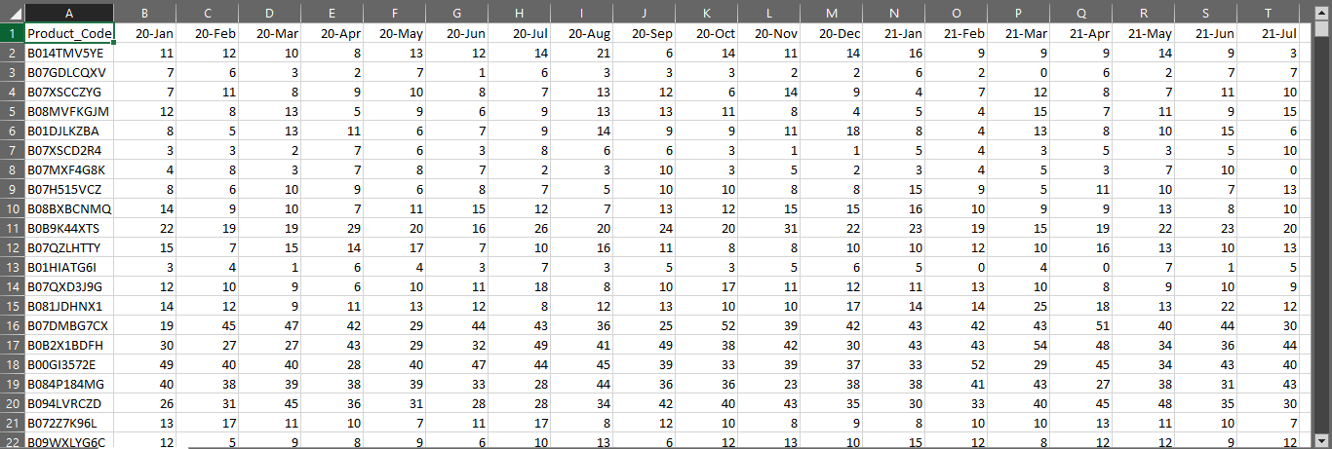
Demo / Working Model
Dataset (1 Million Amazon Products)

Slide 18
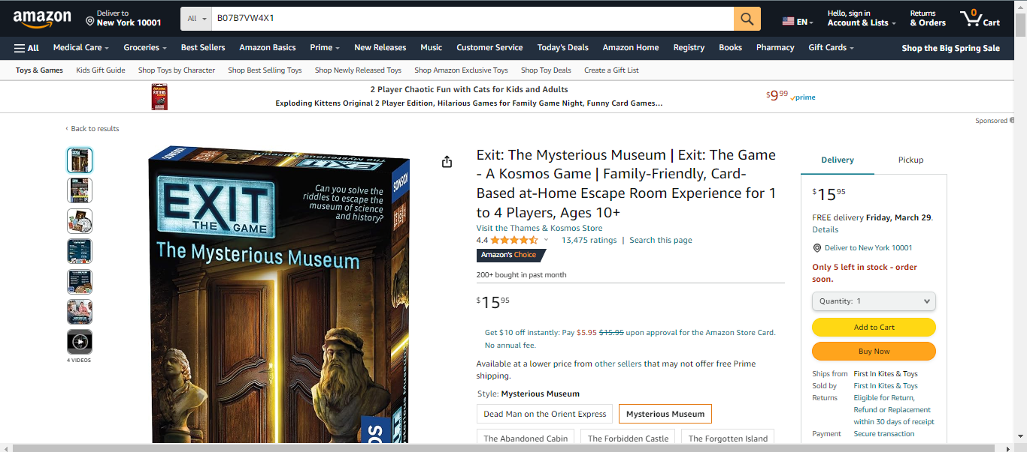
Demo / Working Model
Product Listed on Amazon

Slide 19
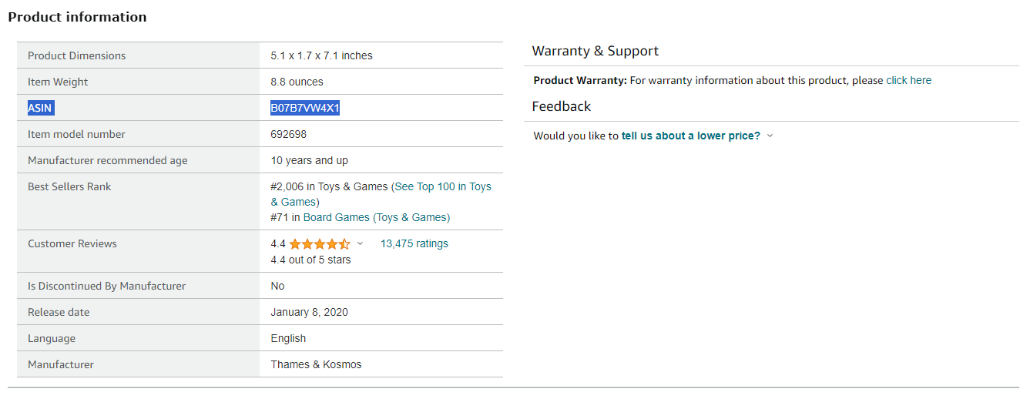
Demo / Working Model
ASIN (Amazon Standard Identification Number) Code

Slide 20
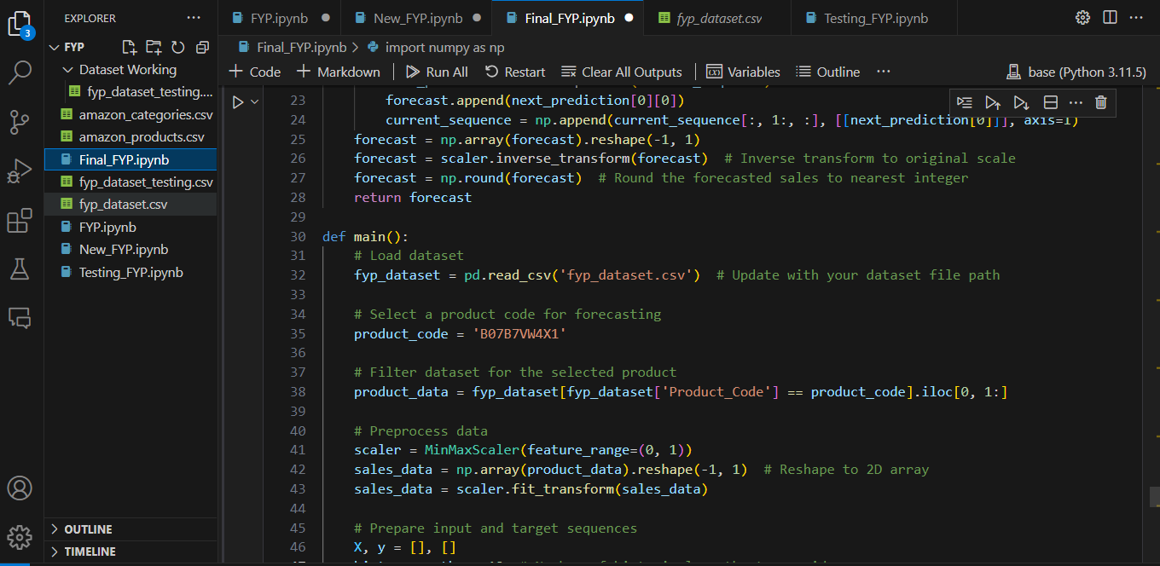
Demo / Working Model
Searching from ASIN

Slide 21
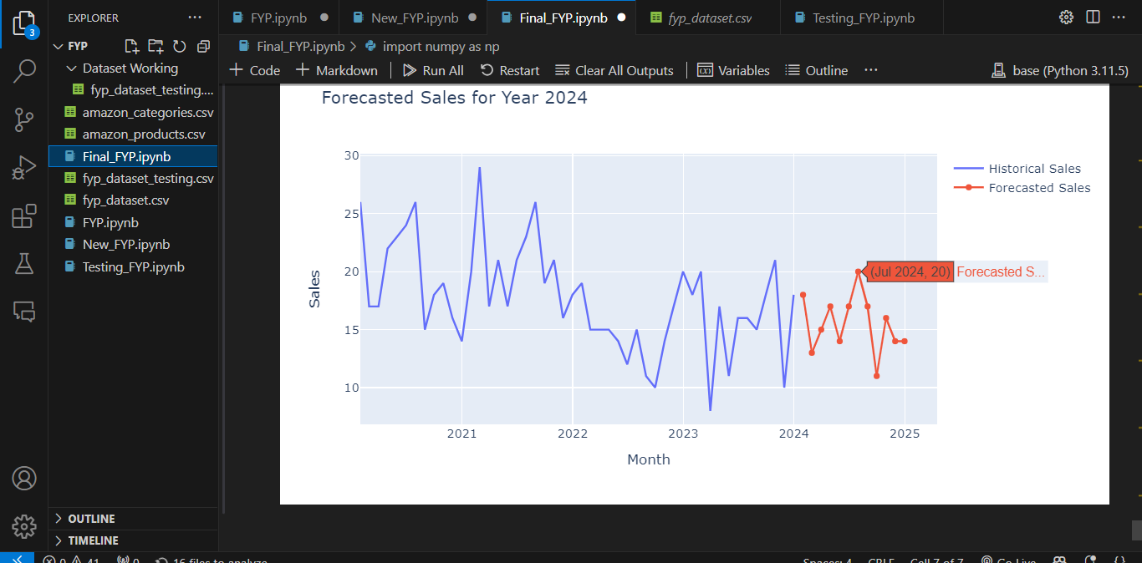
Demo / Working Model
Tracking and Forecasting Stats

Slide 22
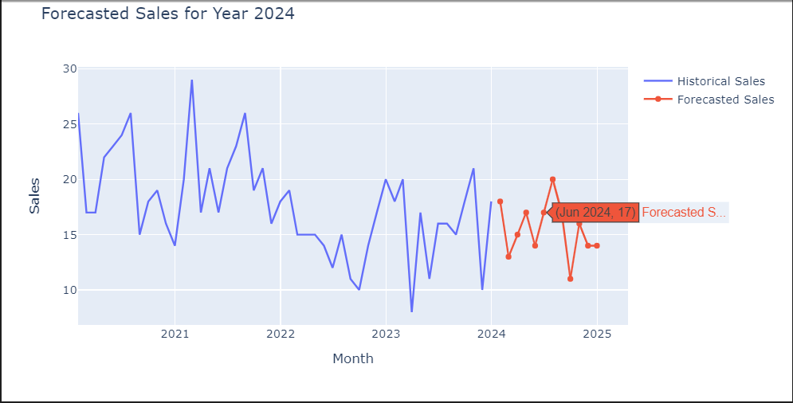
Demo / Working Model
Forecasting Stats (Complete View)

Slide 23
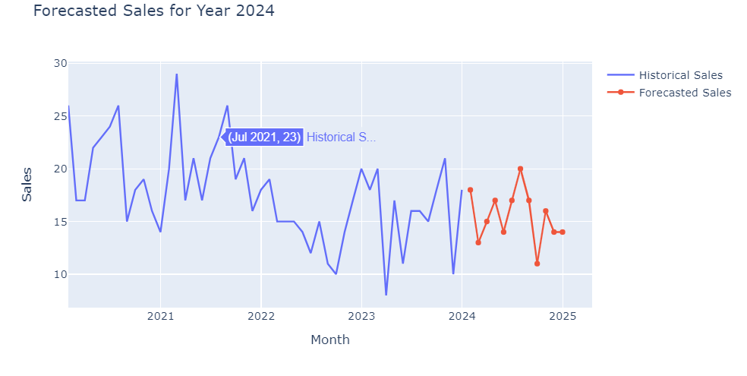
Demo / Working Model
Tracking Stats(Complete View)

Slide 24
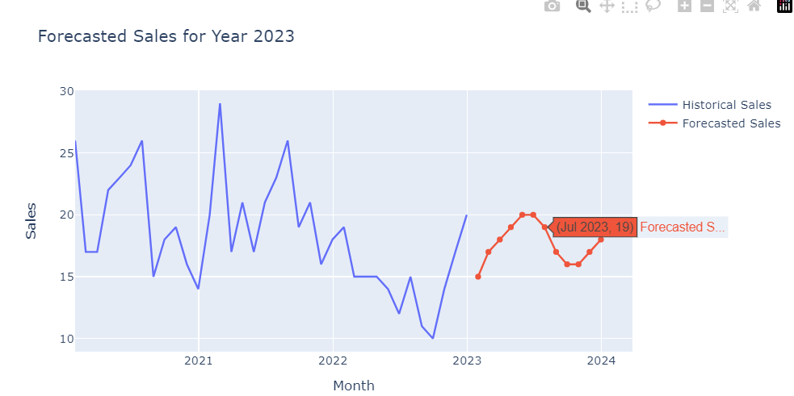
Demo / Working Model
Testing of Sales from Current Year for our Model Validation and Accuracy Stats

Slide 25
Demo / Working Model
Testing of Sales from Current Year for our Model Validation and Accuracy Stats

Slide 26
Literature Review
Project Title : Sales Forecasting Tool For E-commerce
THANK YOU

